Slide 1
Final Portfolio
By: Kameron Jester

Slide 2
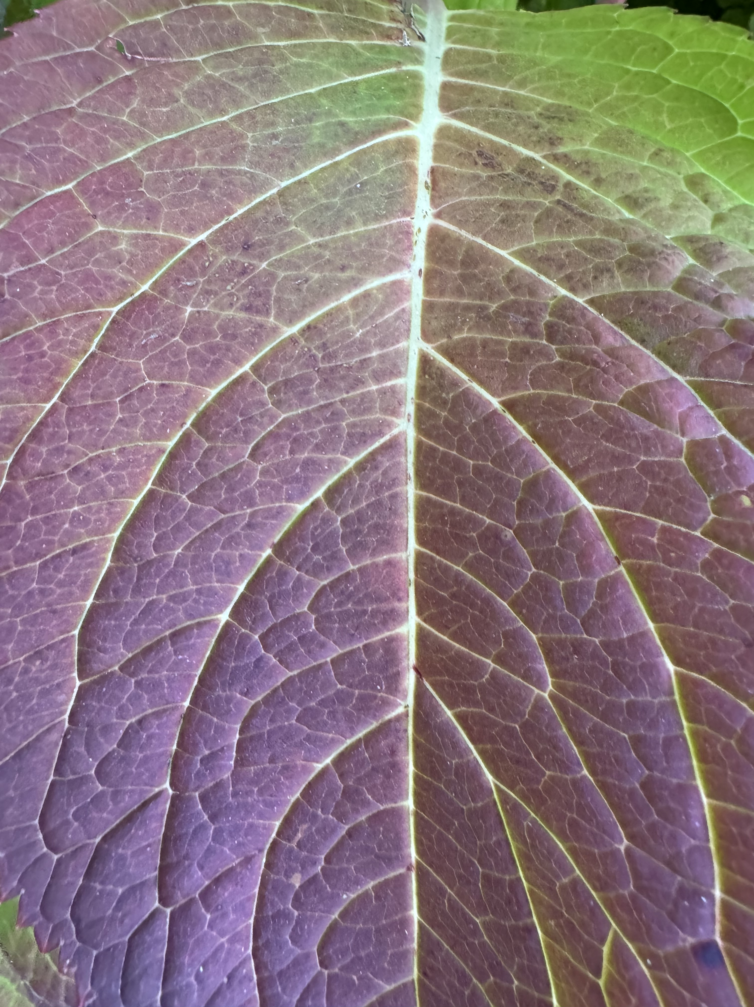
1. Pattern
Changing Colors of The Season
Kameron Jester
Kenosha, WI
10/18/2024
I chose this image because it shows how the colors of nature are changing with the season. Also, I really liked how within the image there is a pattern with the lines on the leaf. I like how this image chows the fading of the green to a dark red/purple. I think it is interesting how the lines on the leaf create a patter

Slide 3
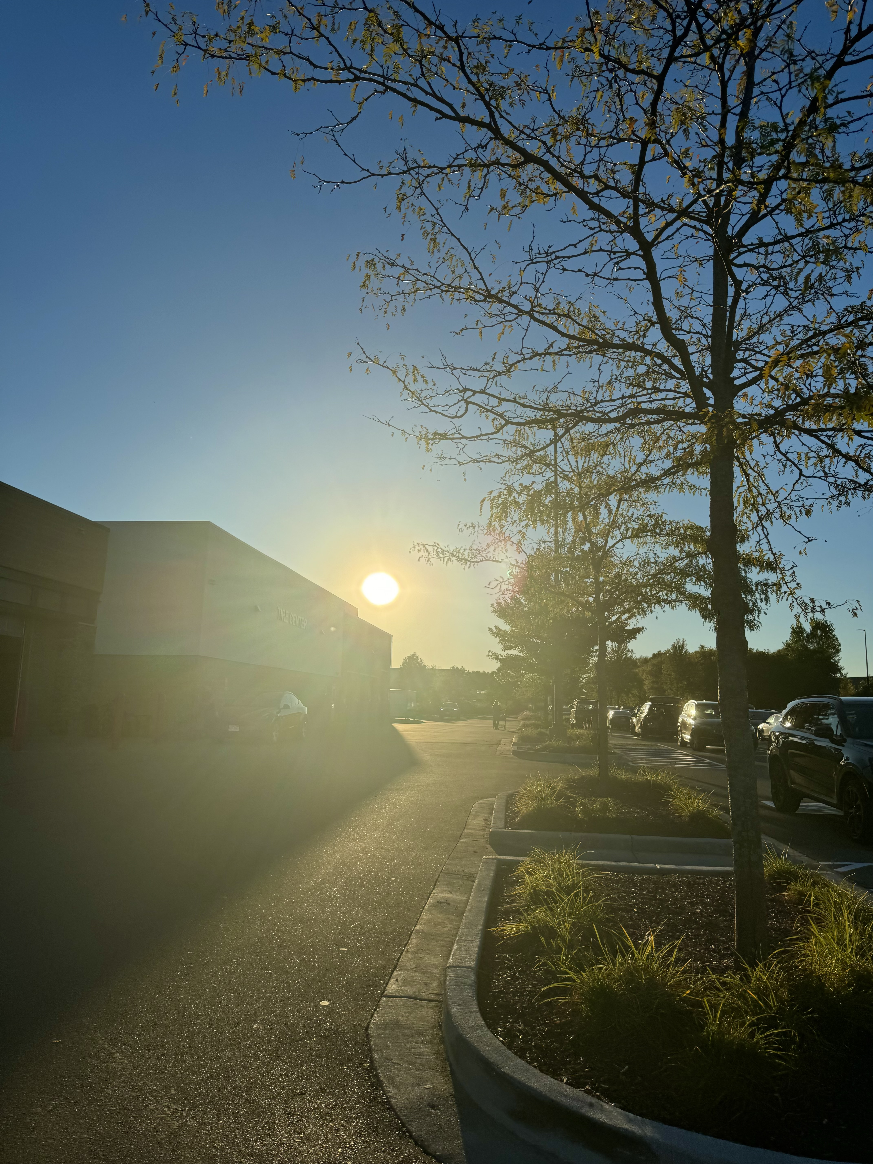
2. Creative Ambient Light or Color
Sunset Shopping
Kameron Jester
Middleton, WI
9/26/2024
While out shipping at Costco the sun was beginning to set. It was the perfect time to stop and take a picture. The focus of this image is the bright sun setting making the surroundings golden and creating shadows.

Slide 4
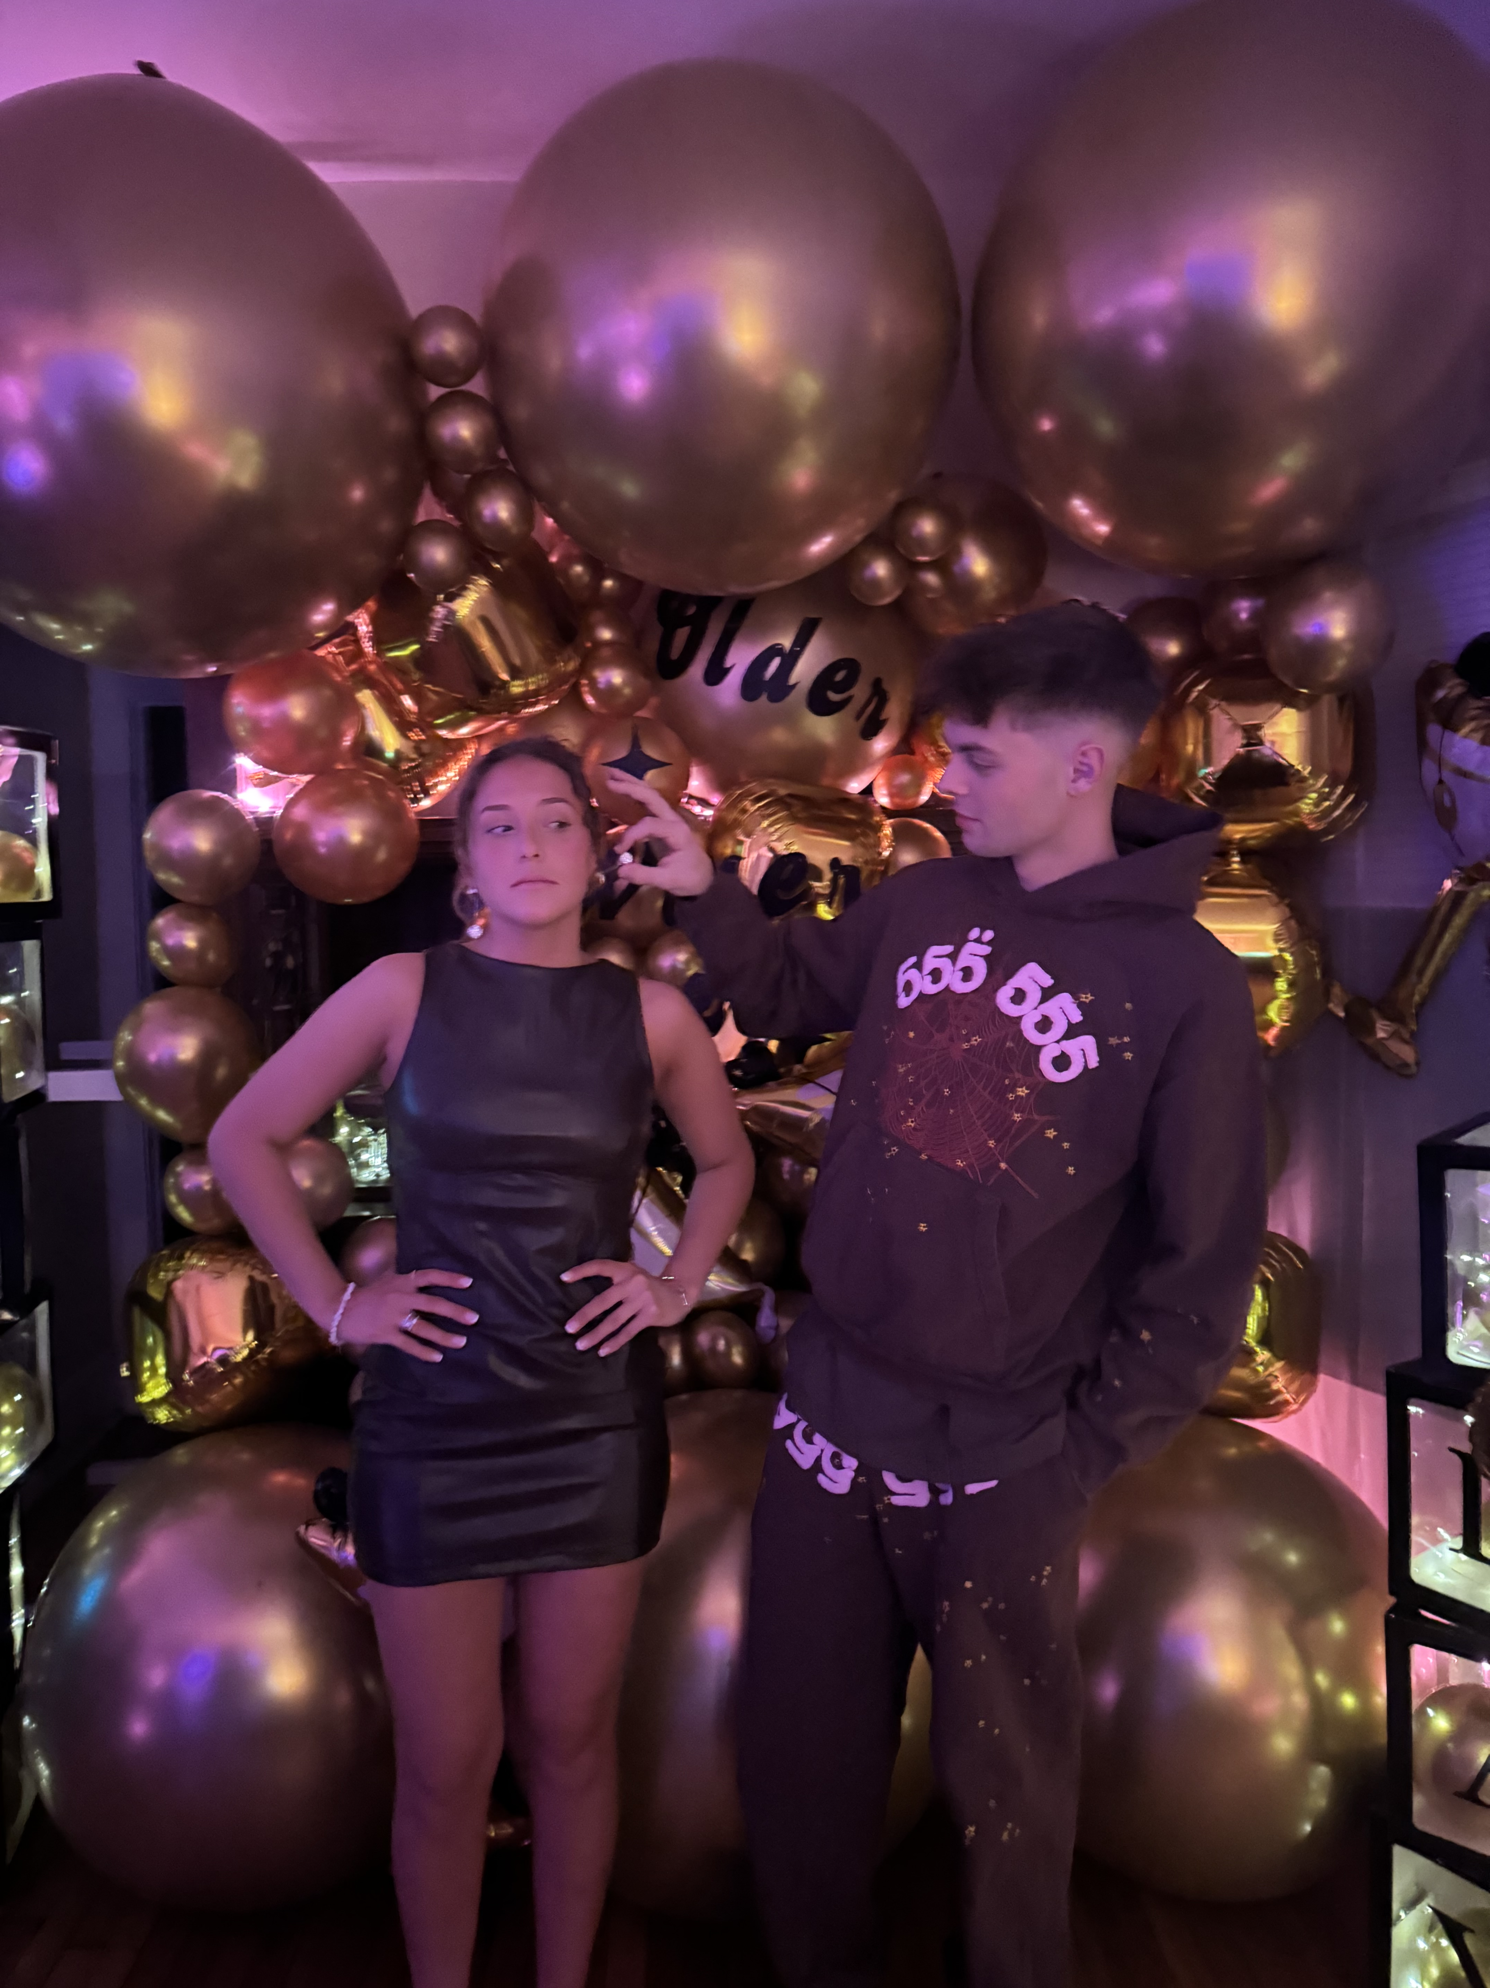
3. Expressive Portrait
Birthday Girl Is Not Having It
Kameron Jester
Milwaukee, WI
11/27/2024
It is my best friends 22nd birthday and we celebrated her in Milwaukee. I earrings, taking pictures and this one captured the silliness of their friendship. She was wearing these big long them, and her friends thought it would be funny to grab them, and she was not a fan of it. I really like how expressive their faces are.

Slide 5
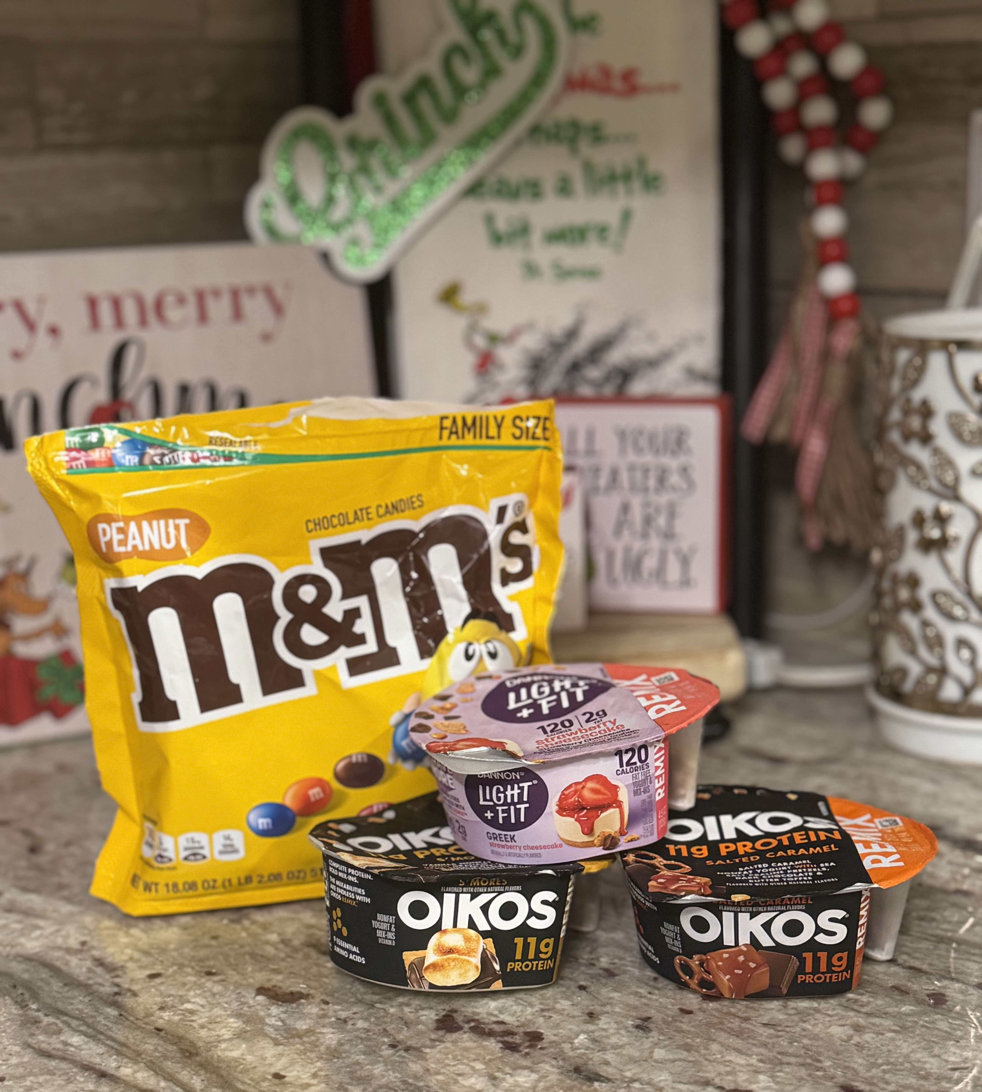
4. Juxtaposition
Healthy vs. Sweet: The Snack Dilemma
Kameron Jester
Kenosha, WI
11/10/2024
With the holiday season beginning all the sweet treats were at while at home. During this holiday season we are all tempted with choosing the healthy food over delicious sweet treats. I wanted to take an image that conveys the juxtaposition between the two sacks with holiday decorations in the background.

Slide 6
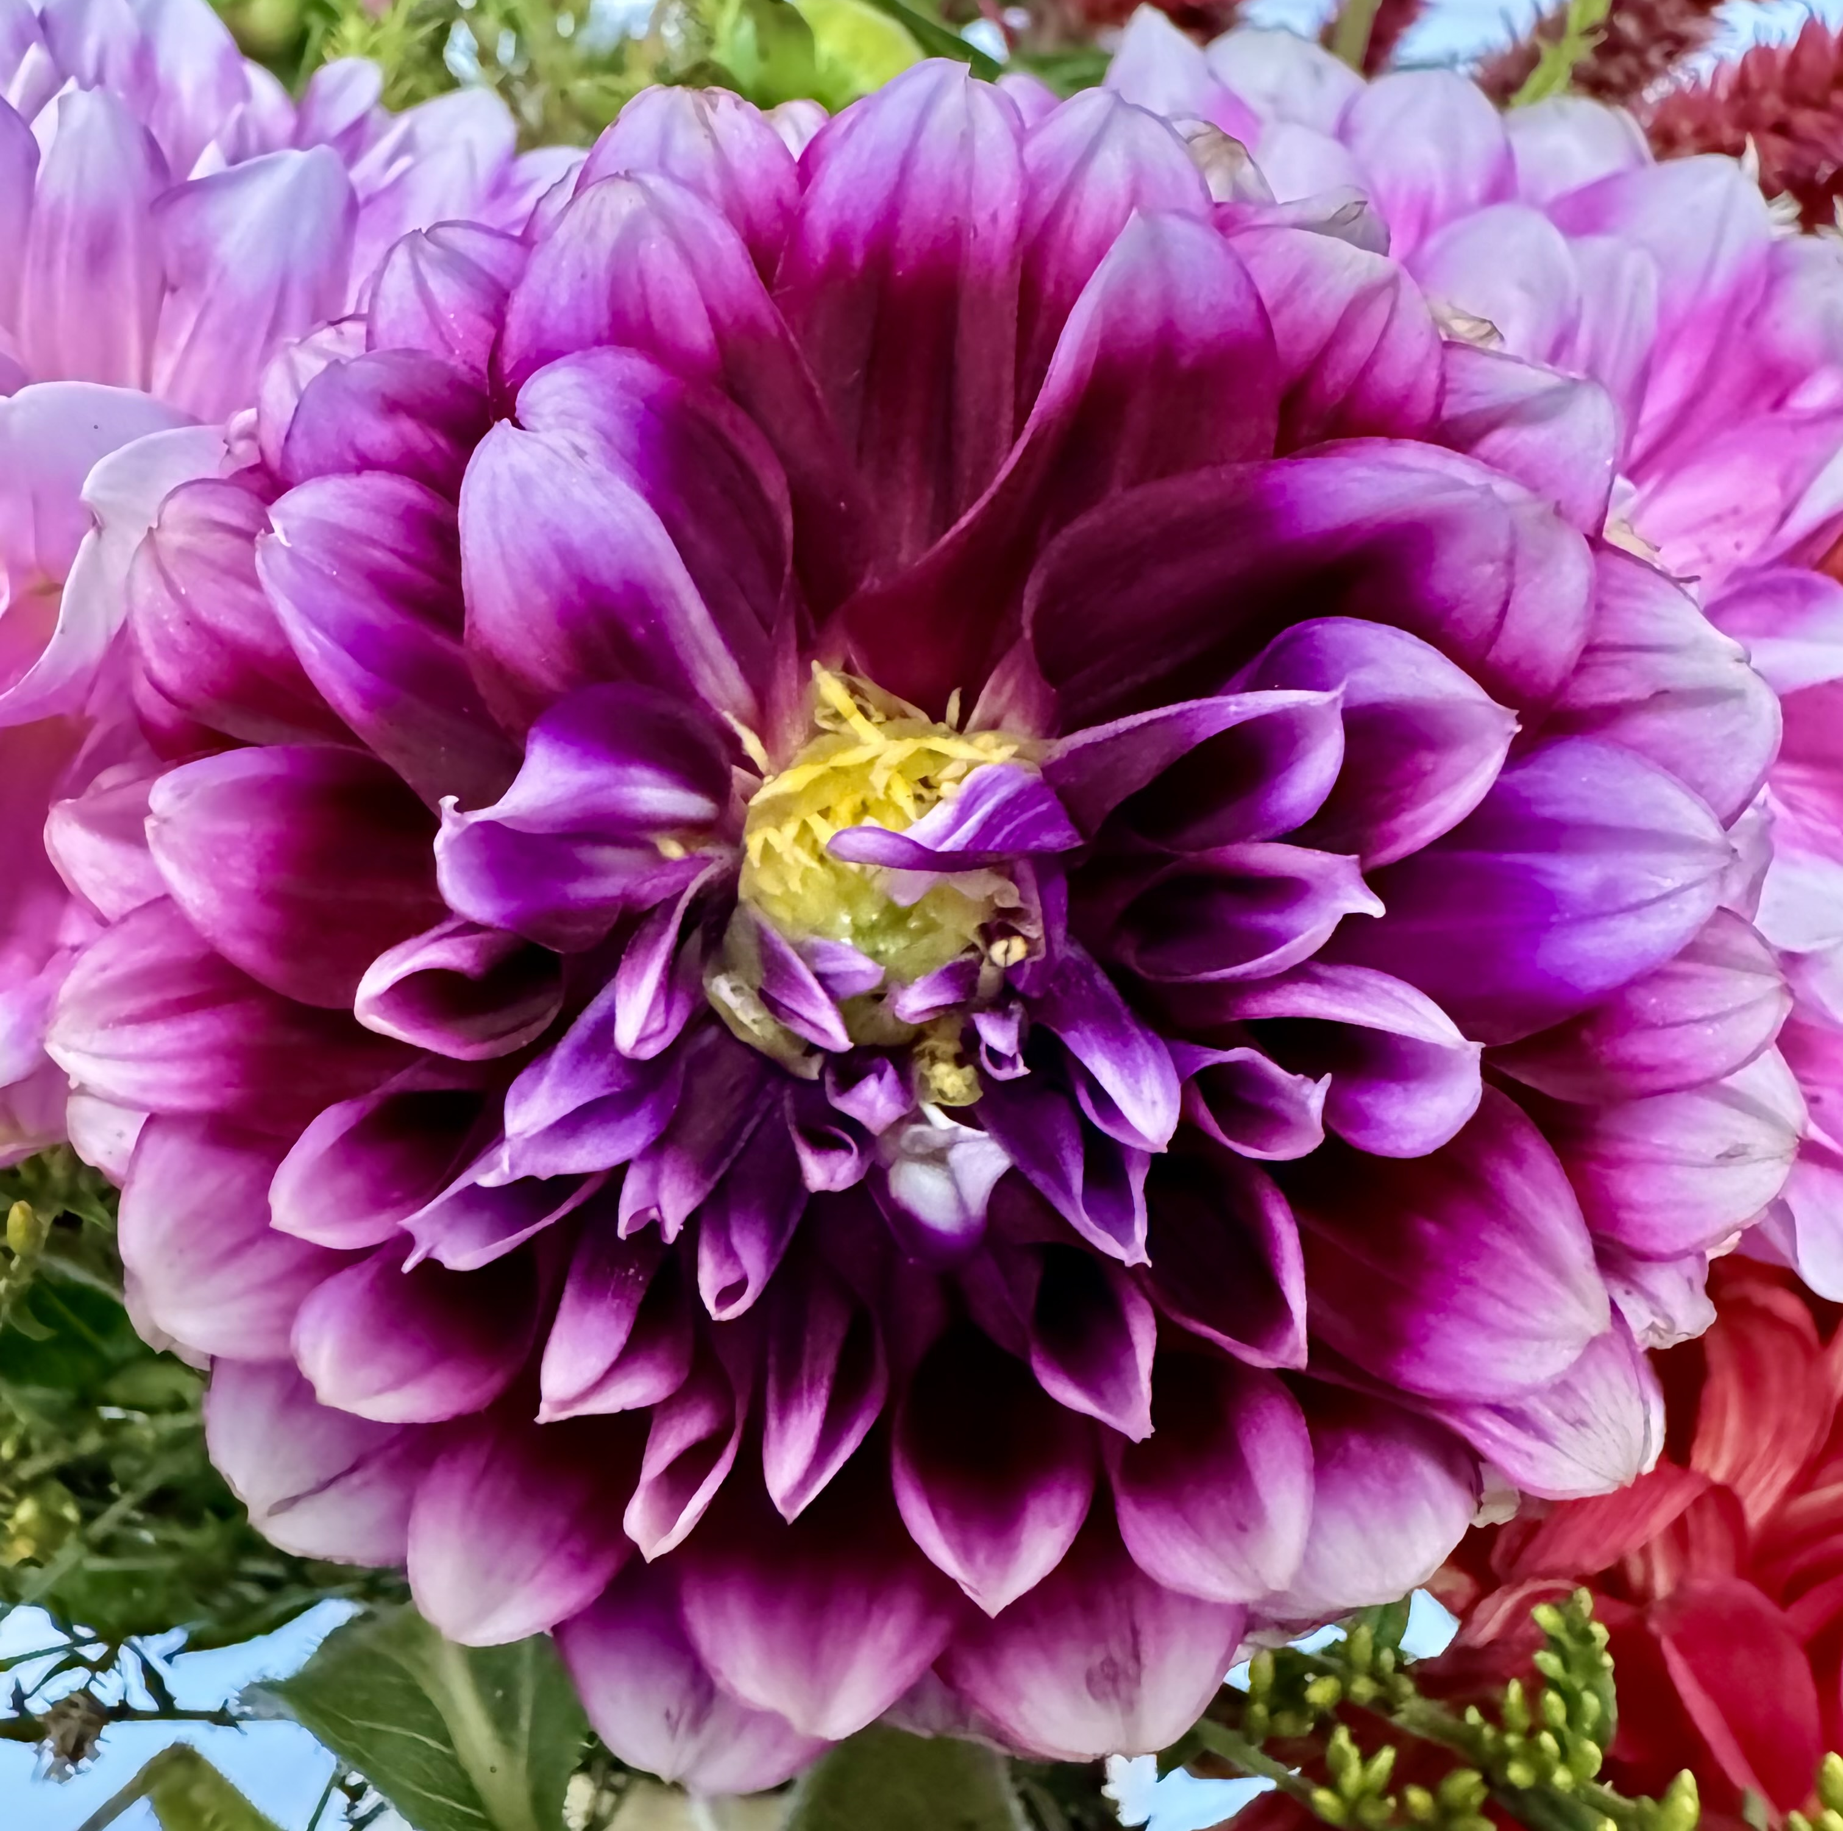
5. Visual Weight
Saturday Market Flowers
Kameron Jester
Madison, WI
9/21/2024 I took this photo of the flowers that I got from the farmer's market. I used the principal of visual weight focusing on radial symmetry to show the petals of the flower. I chose this specific image because it shows off the color and depth

Slide 7
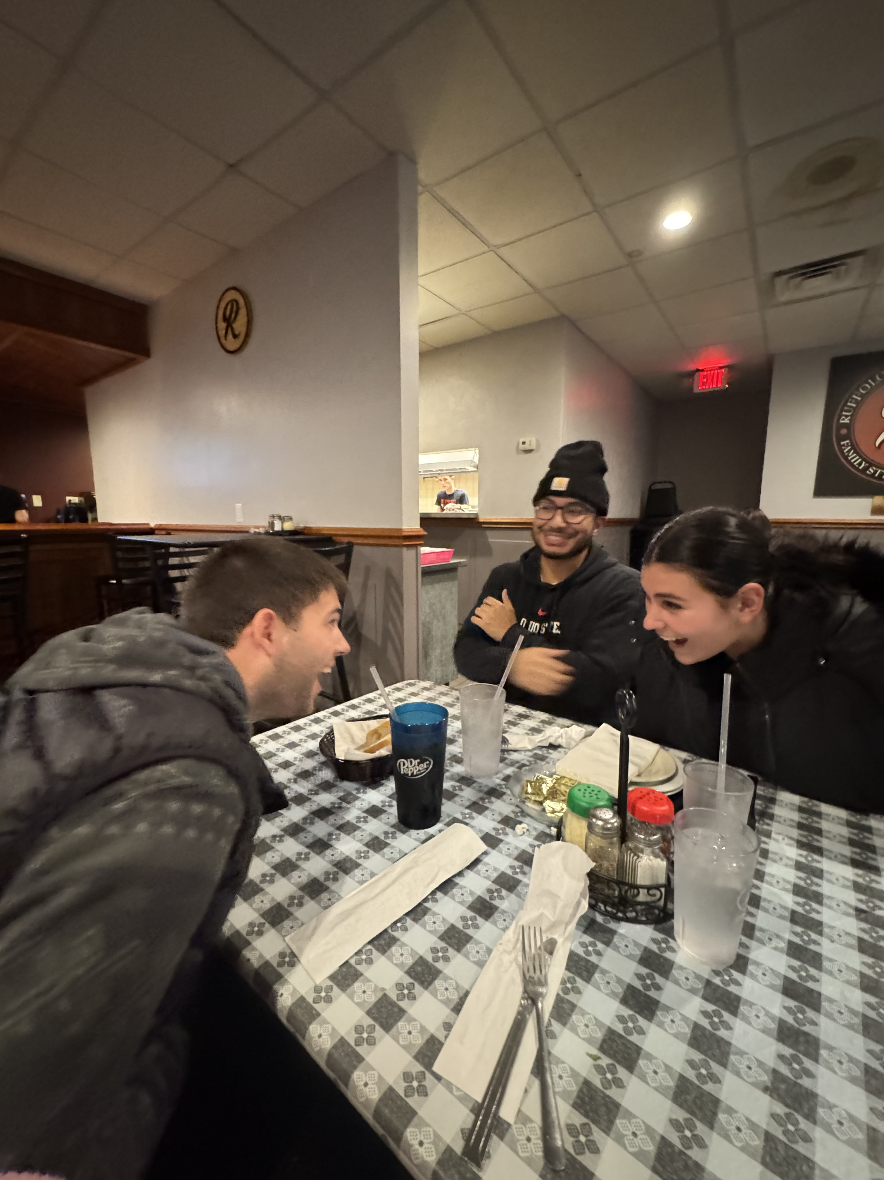
6. Visual Storytelling
The Crew Is Back Together!
Kameron Jester
Kenosha, WI
11/22/2024
One of the best parts of coming home for the holidays is getting together with friends. All of us haven't been together since we all went back to school in late August. There were lots of laughs shared and memories made.

Slide 8
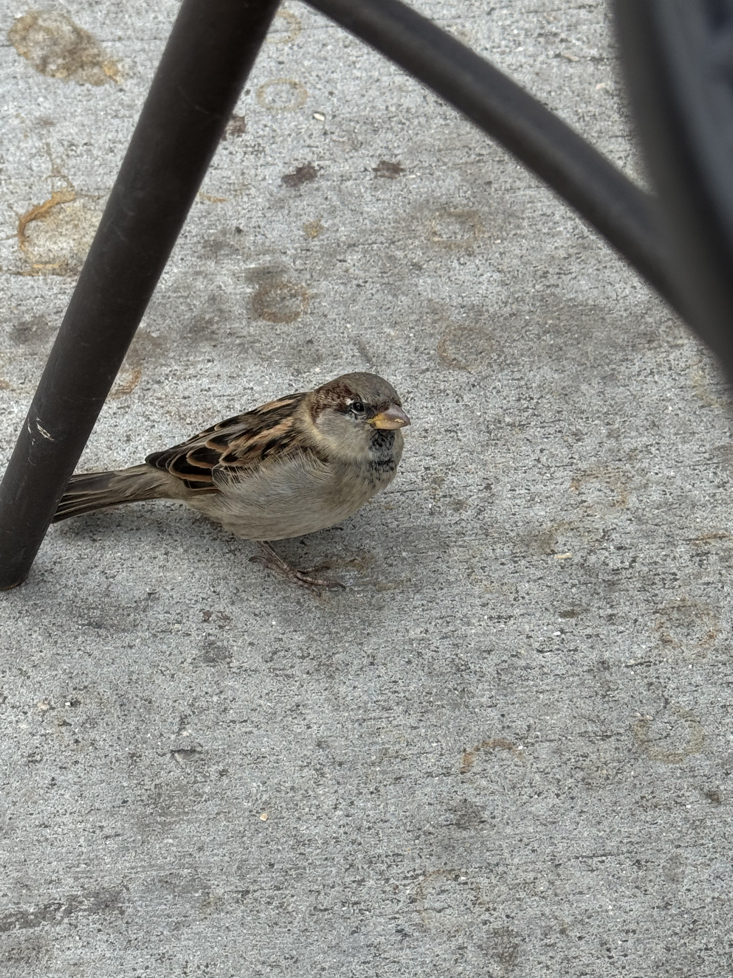
7. Decisive Moment
Feathered Friend Looking for a Treat
Kameron Jester
10/12/2024
Madison, WI
One of the little birds was moving around under my chair looking for food. Since the bird was moving around, I was able to zoom in and wait to capture the moment. With this image I tried to use frame within a frame with the legs of the chair. I love how in this image you notice the colors of the birds' feathers and its beak.

